Slide 1
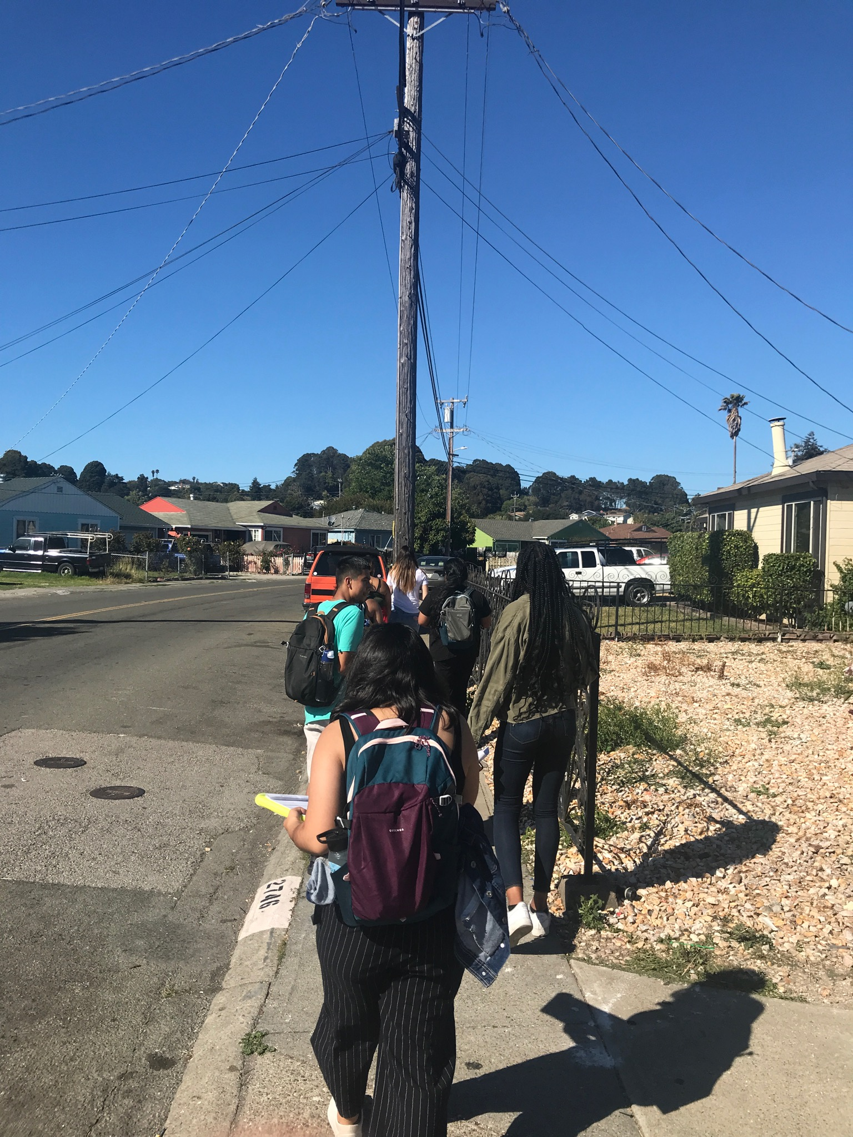
Youth Voices Changing the Way We View Environment and Asthma
By: Sara Madriz, Chris Rayon, Estela Gonzalez, & Jael Hernandez

Slide 2
Summer Project Experience
Asset communities have higher quality of life which includes higher income levels, higher % of homeownership and lower asthma ED visit rates.
The prevalence of asthma in California is approximately 13% and in Richmond, CA, it is 25%
For disorder communities, making it a cleaner environment can possibly improve asthma rates and increase income levels, and homeownership.
Notes:
2

Slide 3
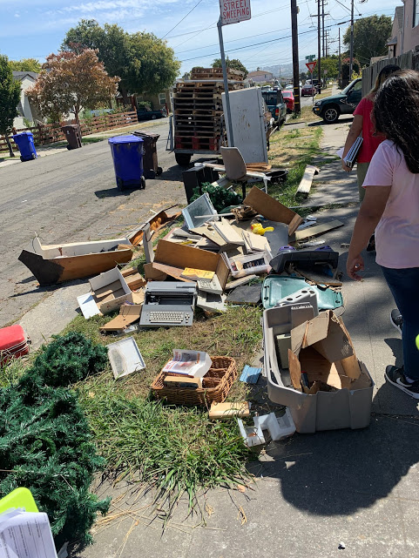
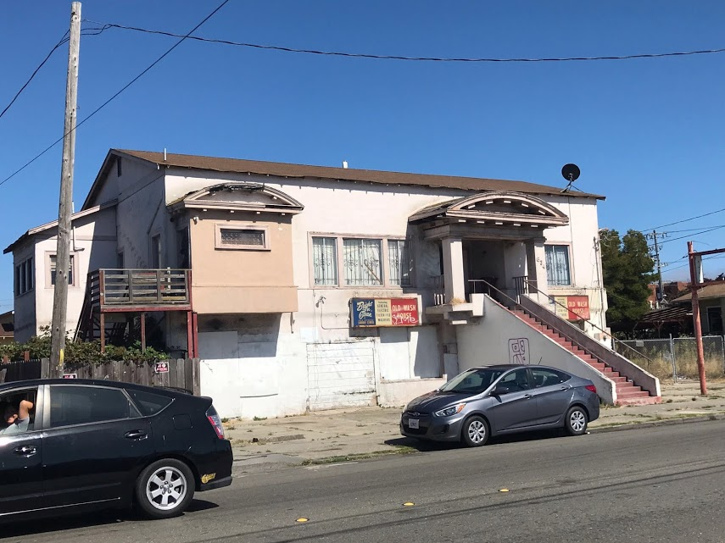
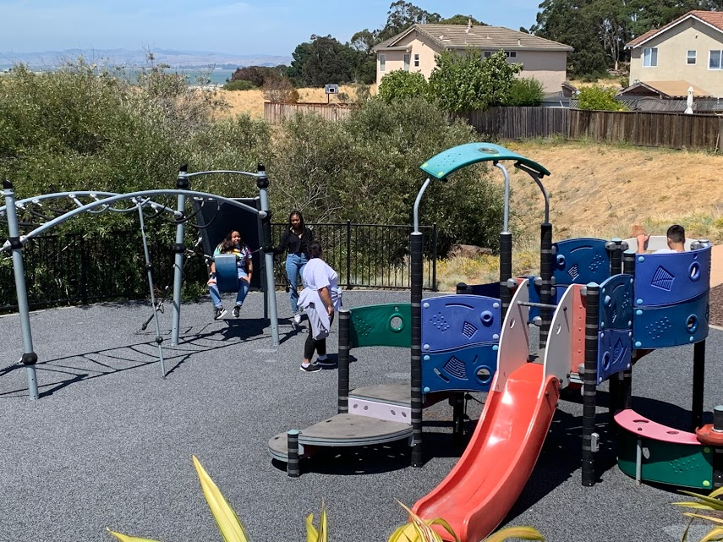
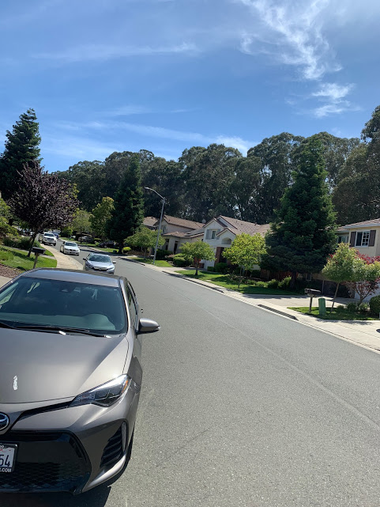
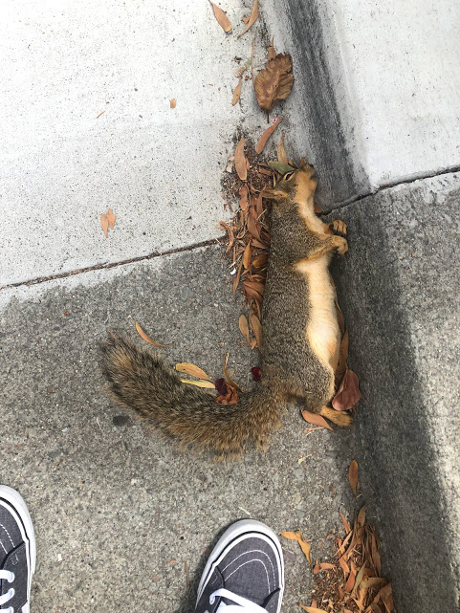
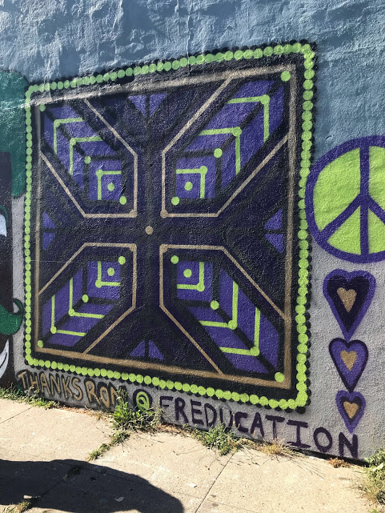
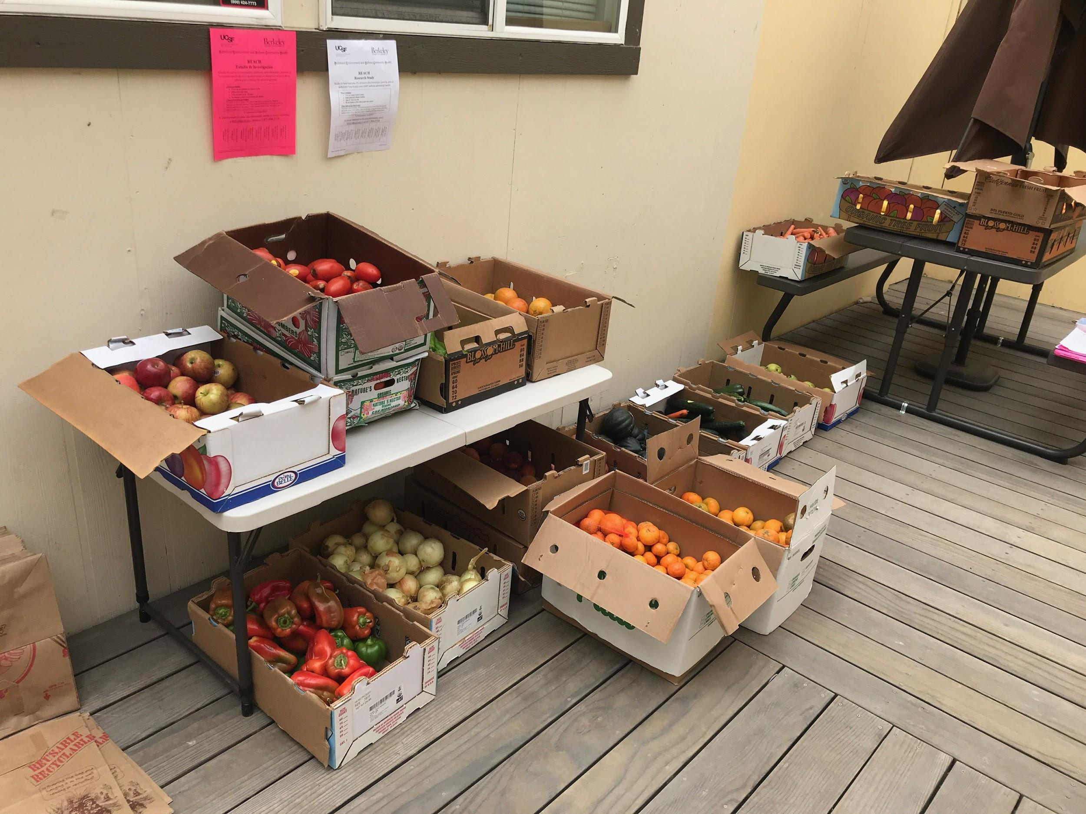
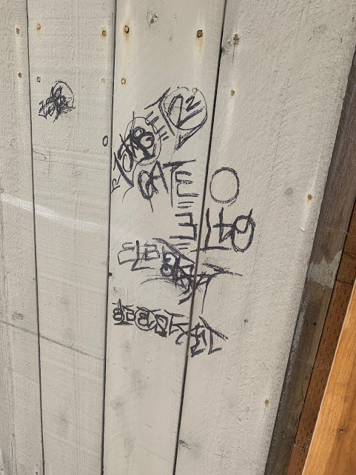
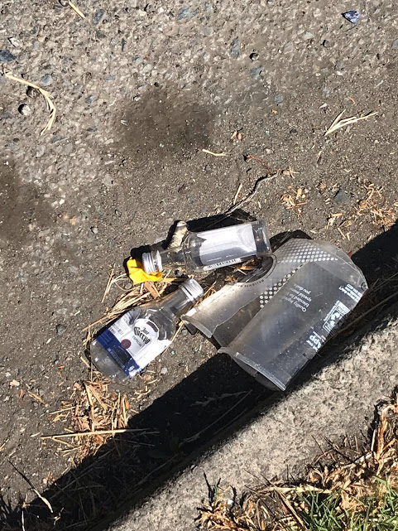
Disorders & Assets

Slide 4
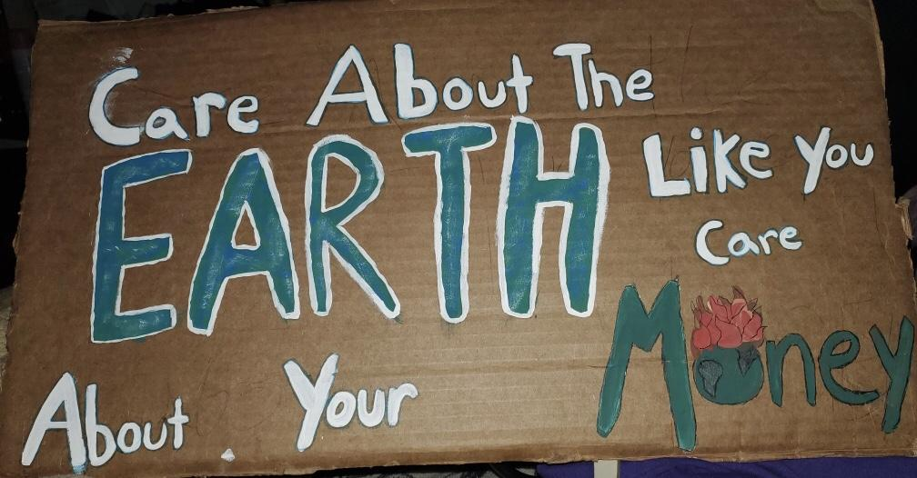
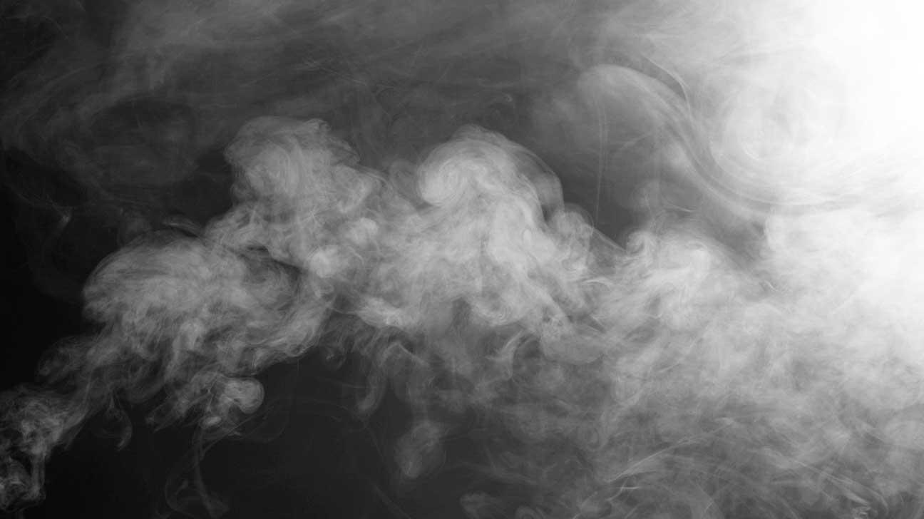
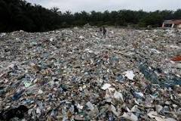
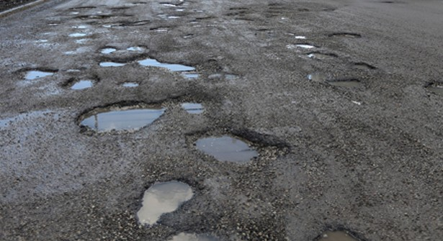
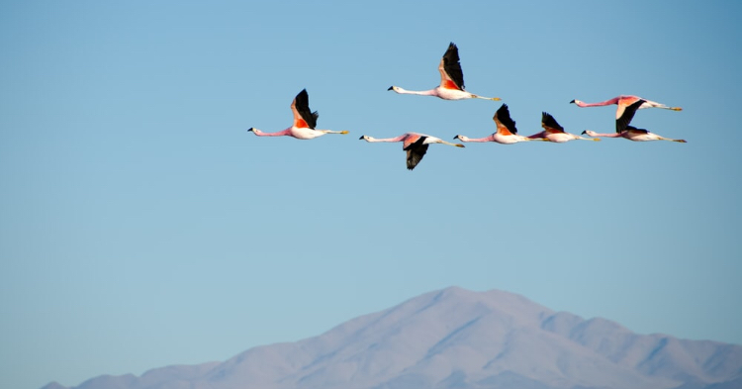
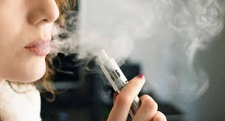
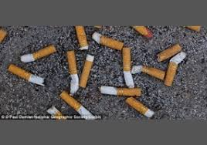
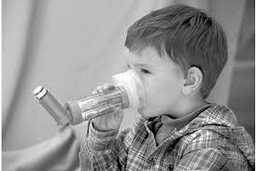
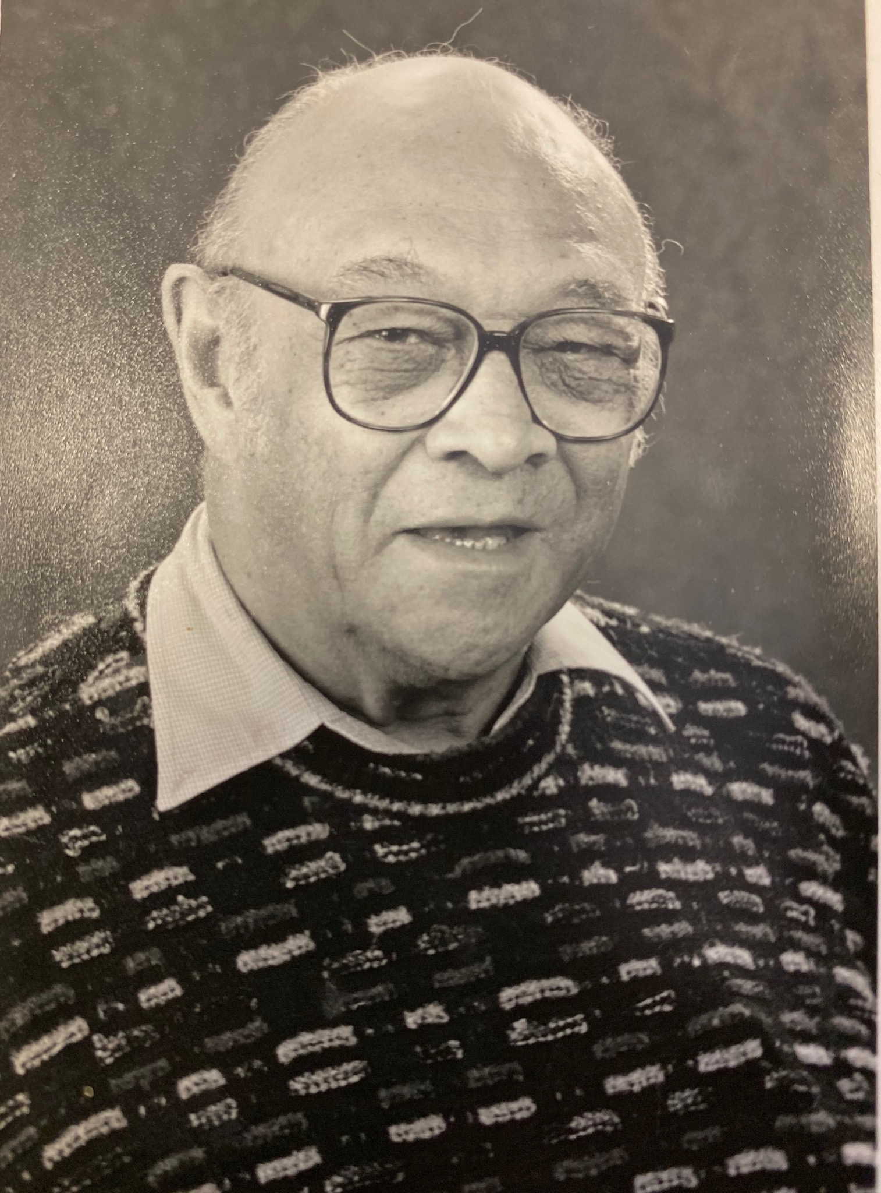
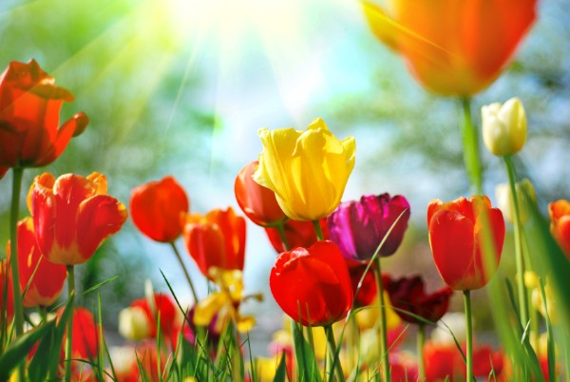
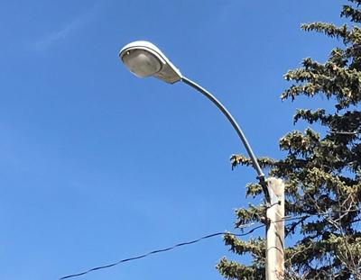
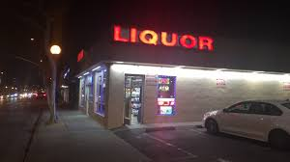
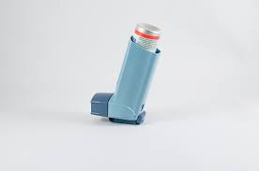
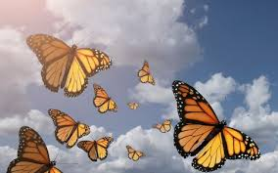
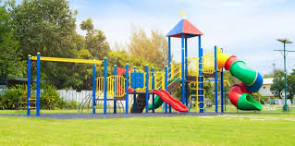
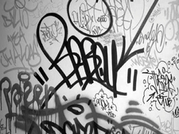
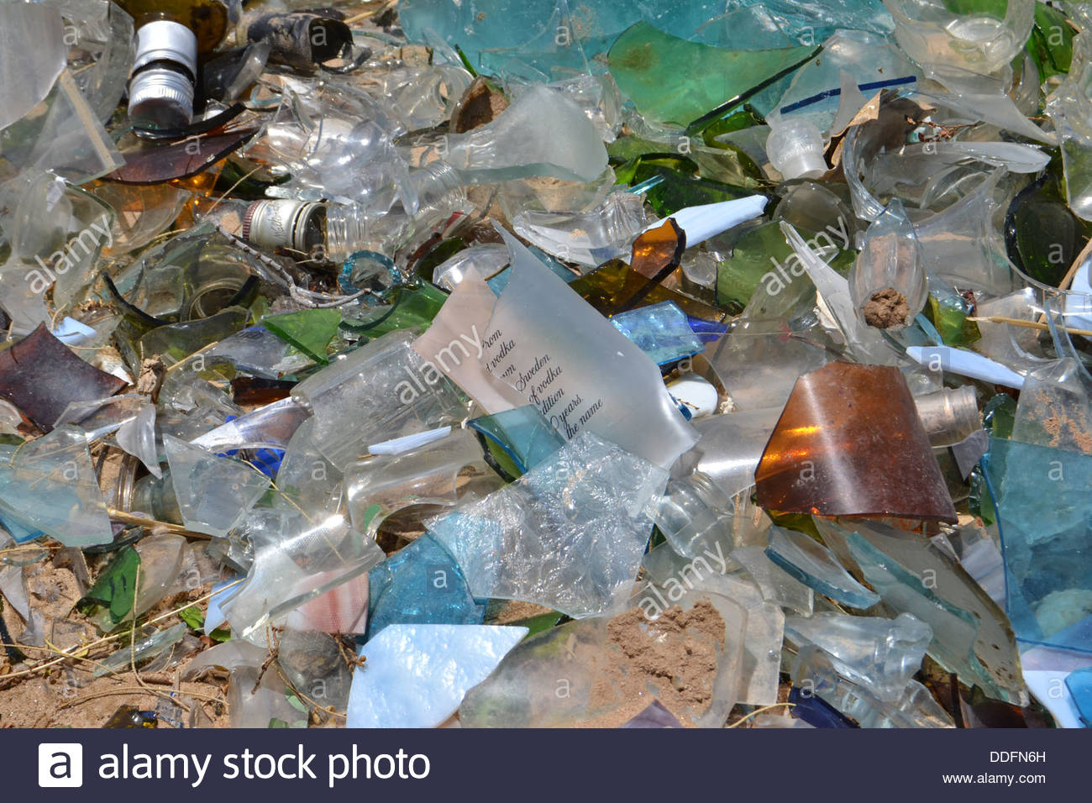
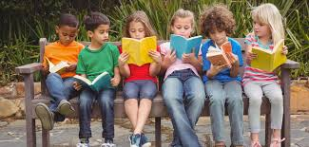
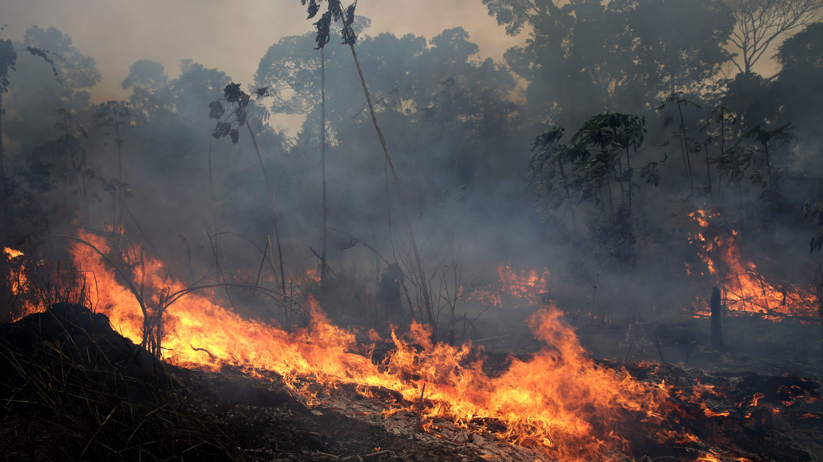
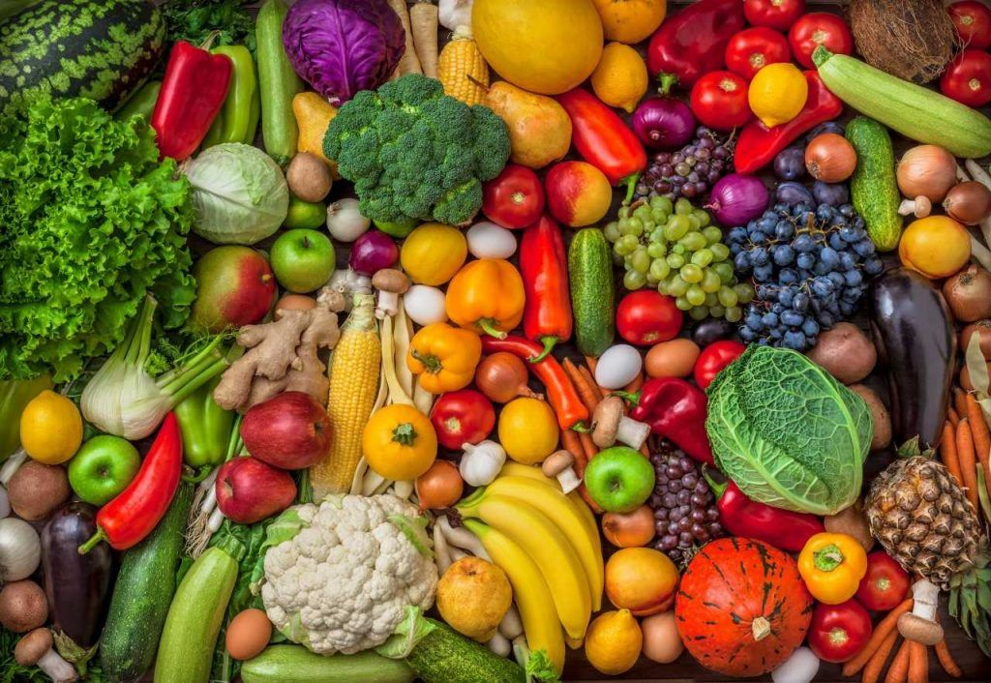
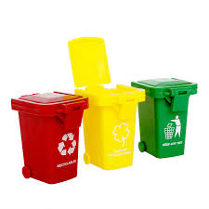

Slide 5
Community Activities
Community members will be invited to volunteer in the mural process such as wall choice, color choices, and painting.
Painting techniques and mixing colors will be taught. Volunteers will be trained in order for them to teach other community members.
Engage youth in order to show the relationship between community involvement and the arts
We will host a community block party to celebrate the completion of the mural and bring more awareness to the mural

Slide 6
Goals
To educate and engage residents in Richmond in community talks for proactive change
To show residents how cleaning up disorder can have positive impacts on our health and environment
To remind the community that youth are the future and part of the change in our communities

Slide 7
Measurable Outcomes
A majority of our community members will be able to identify the number of assets and disorders in our community.
Document and share the influence of the mural through photos and videos and the effects on policy making in the Richmond community.
The mural will have 5 college students and 30 additional youth participating in the painting process.

Slide 8
Timeline
First month we will meet to plan more concrete ideas on design and color
Hire local artist and secure location for mural in Richmond
Look for volunteers in the community
3-4 hour painting sessions for 6 weeks
Train volunteers

Slide 9
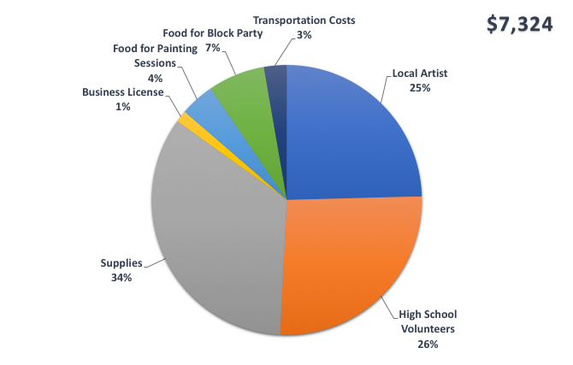
Budget

Slide 10
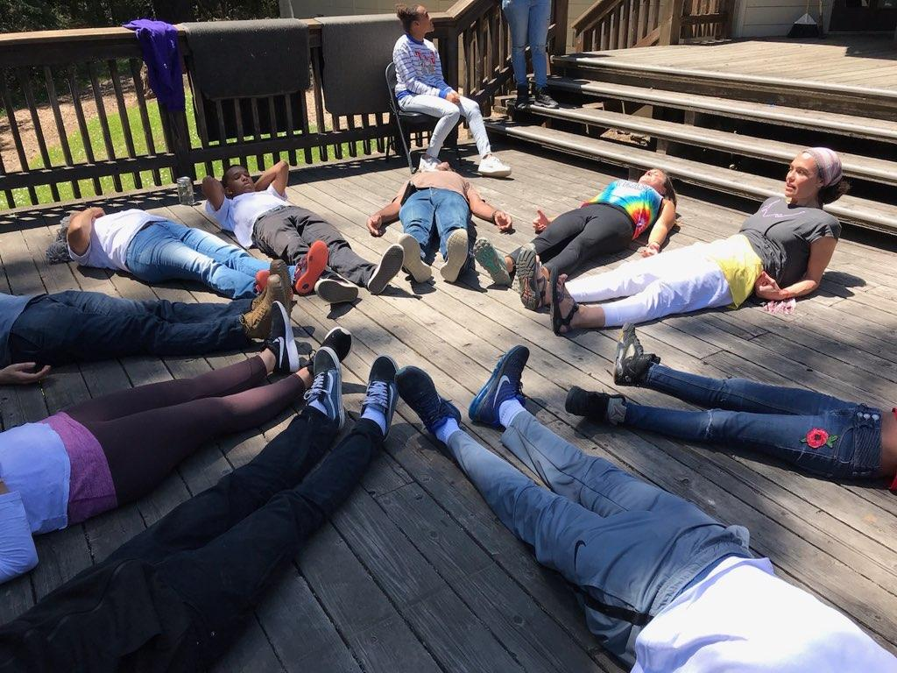
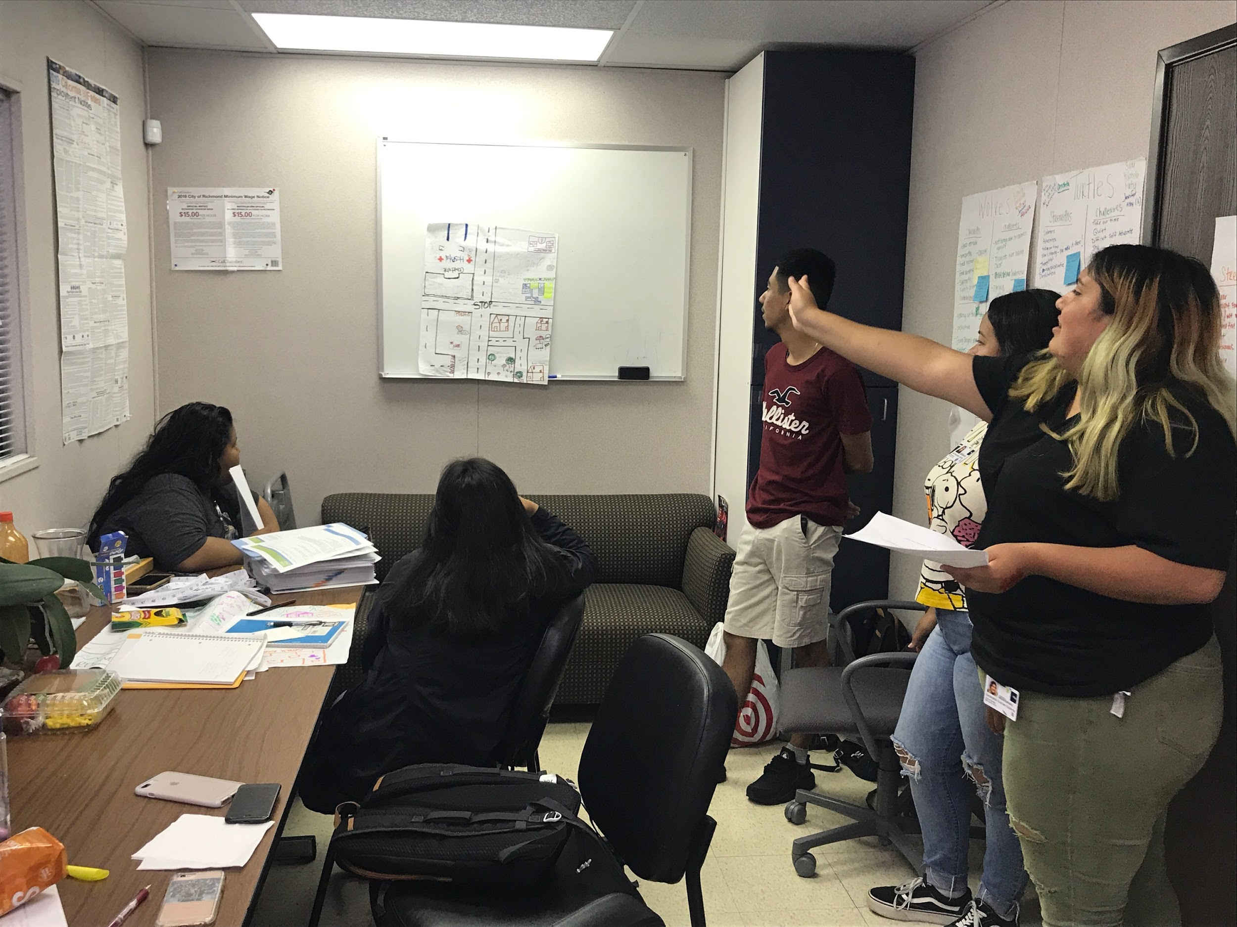
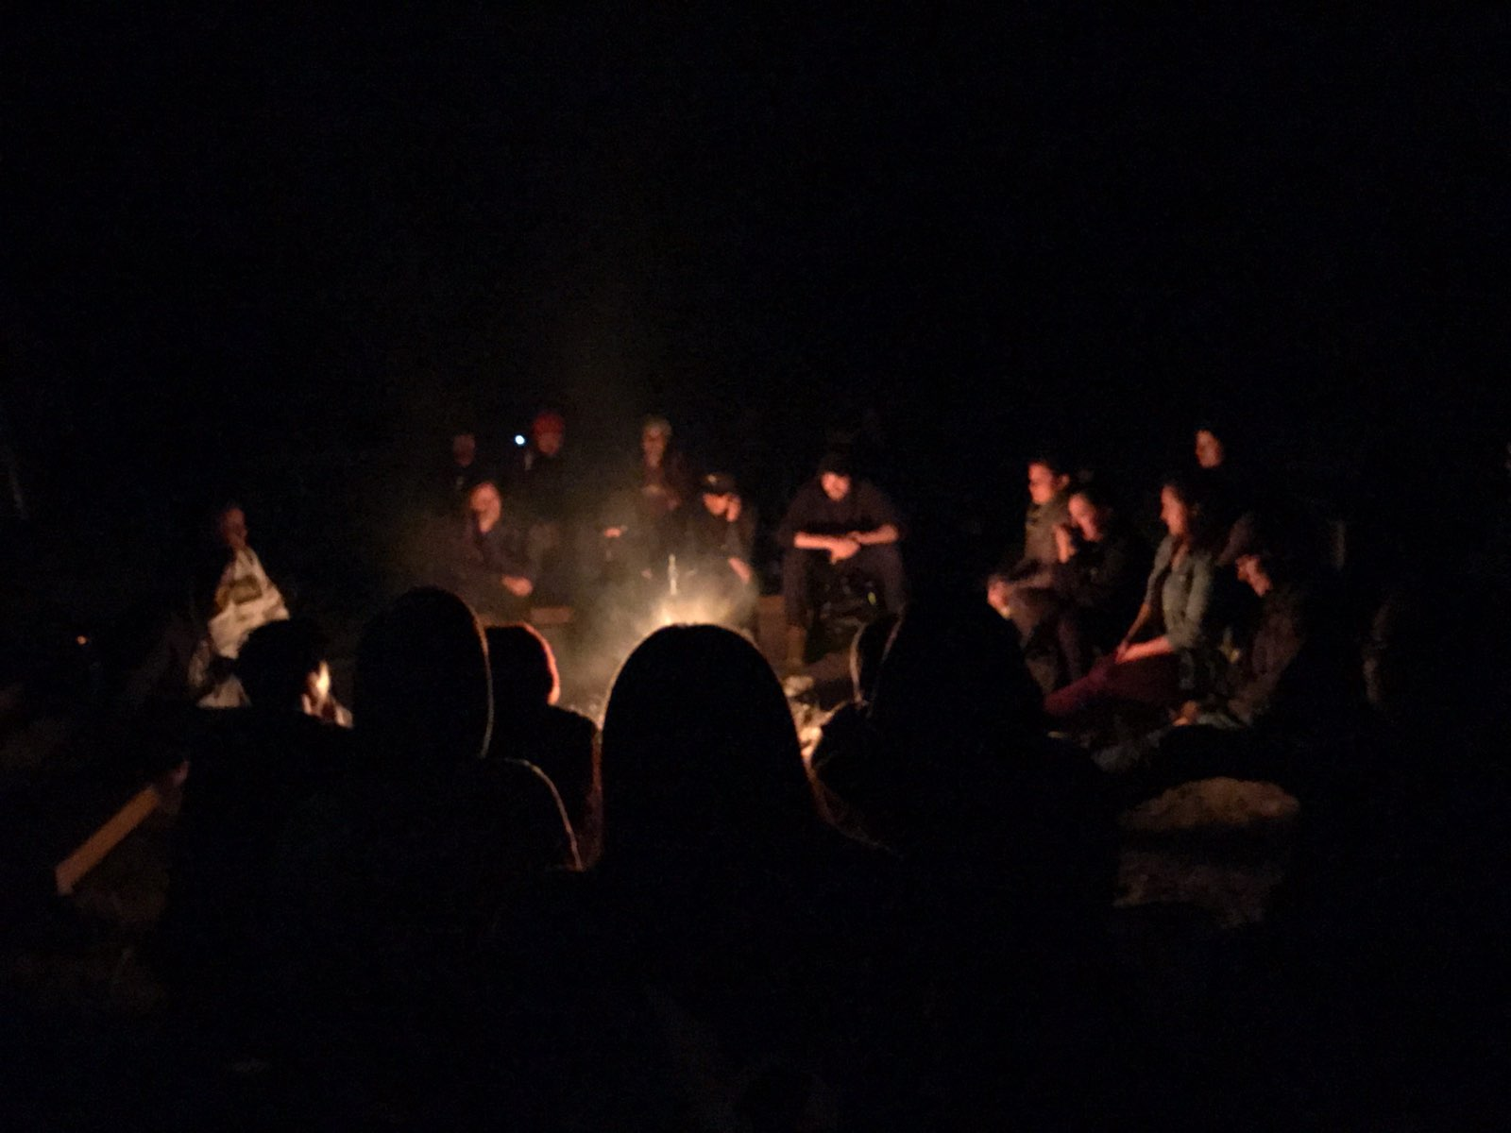
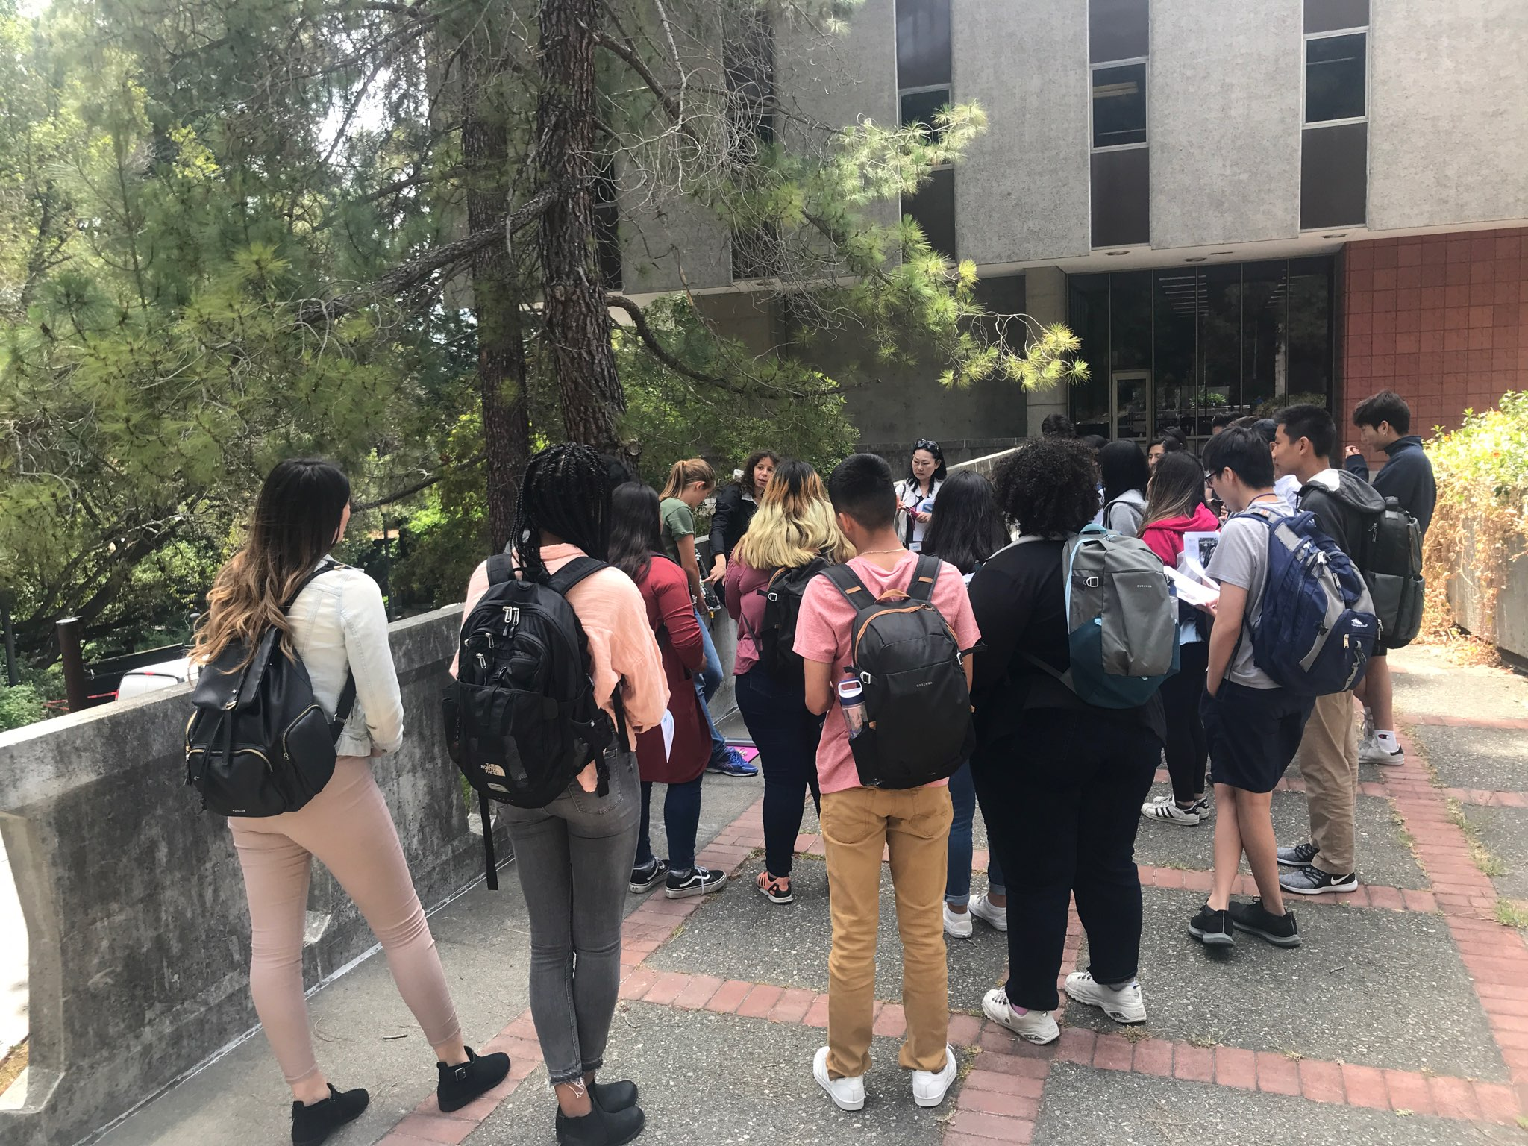
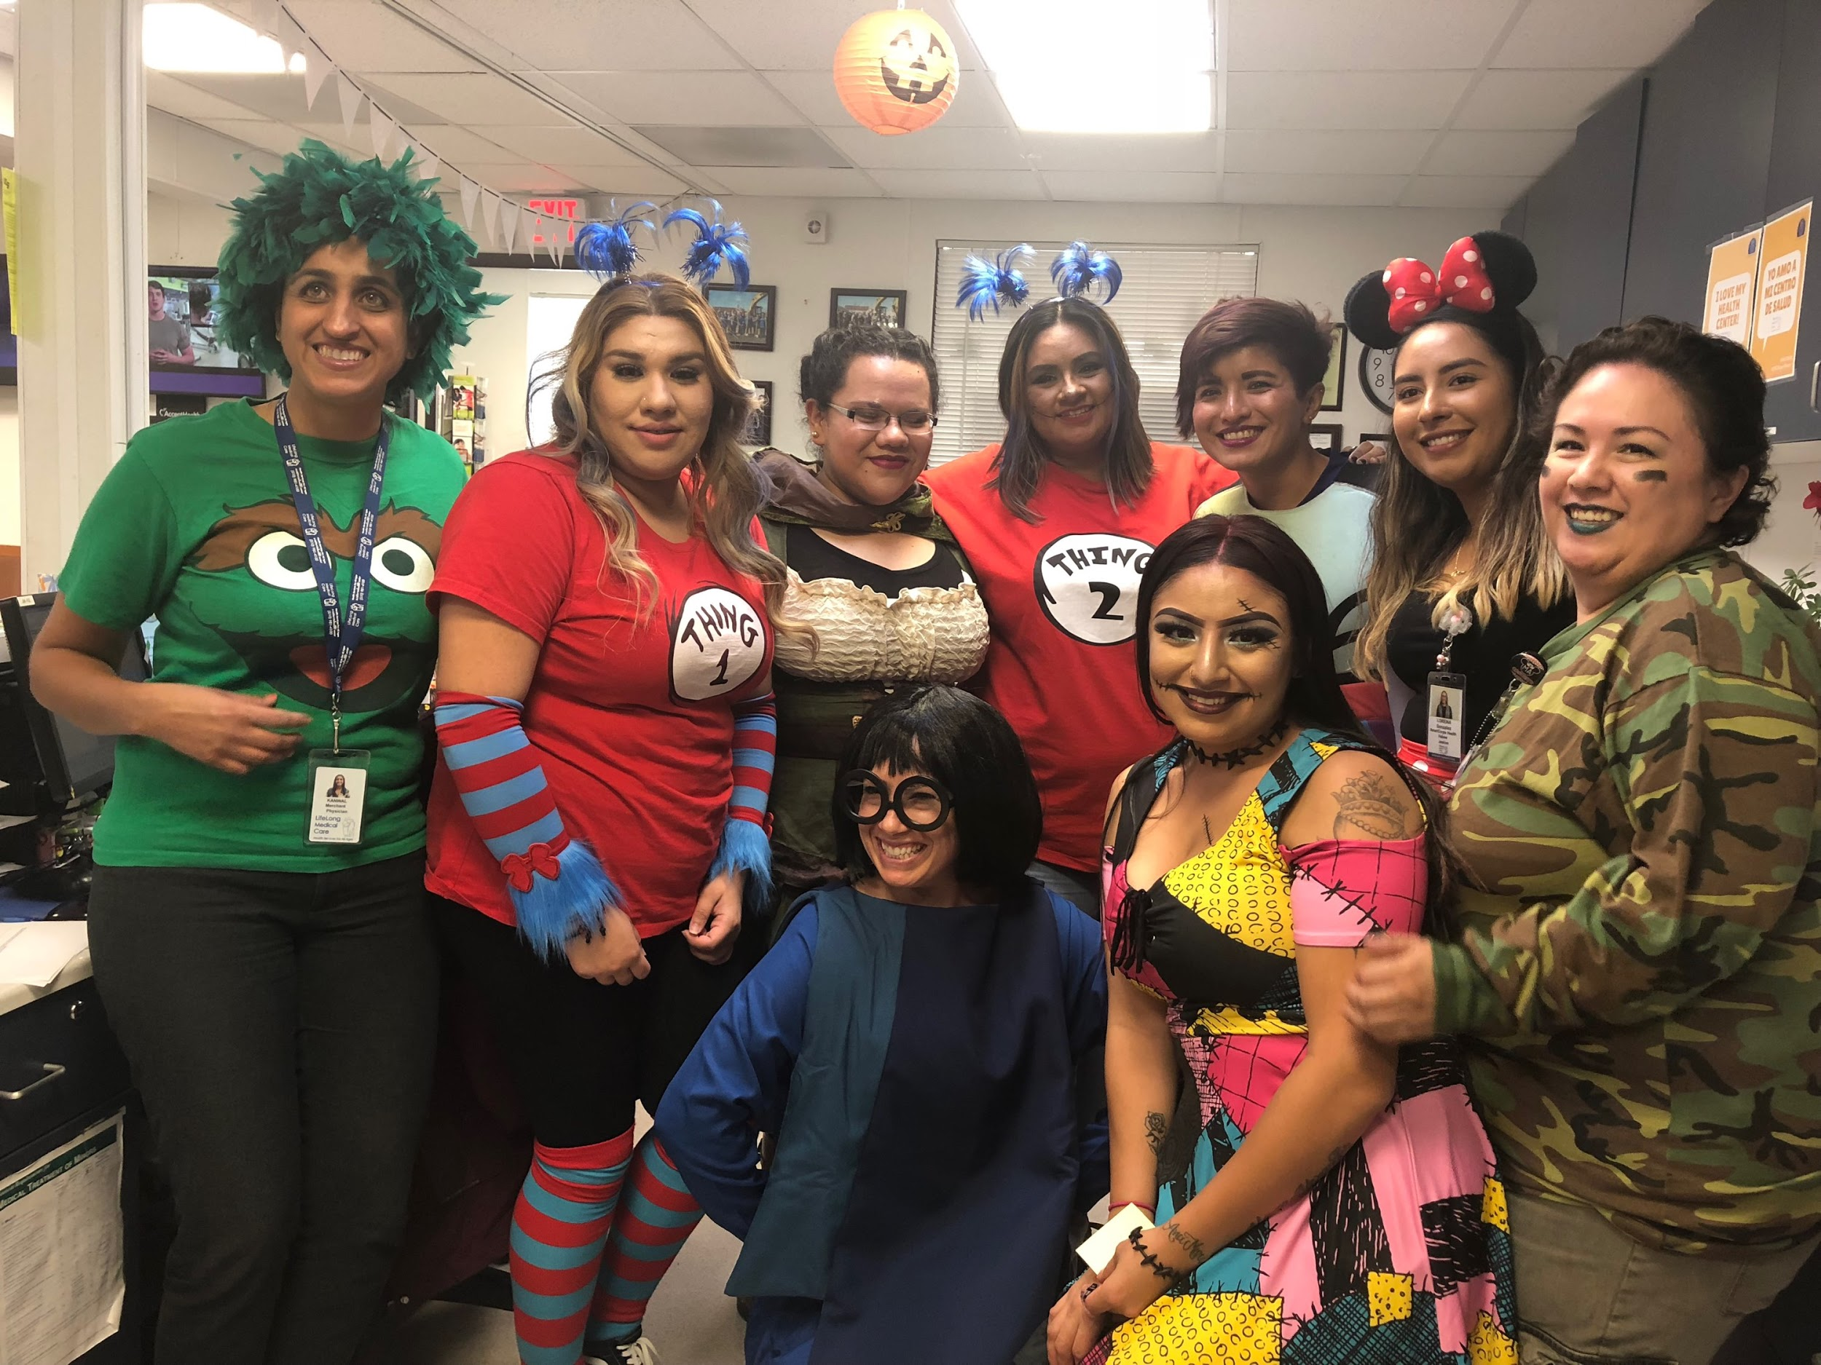
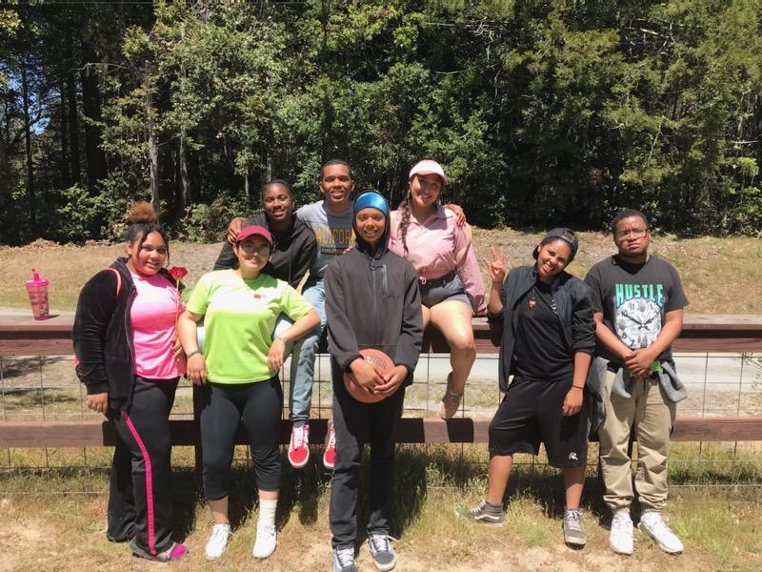
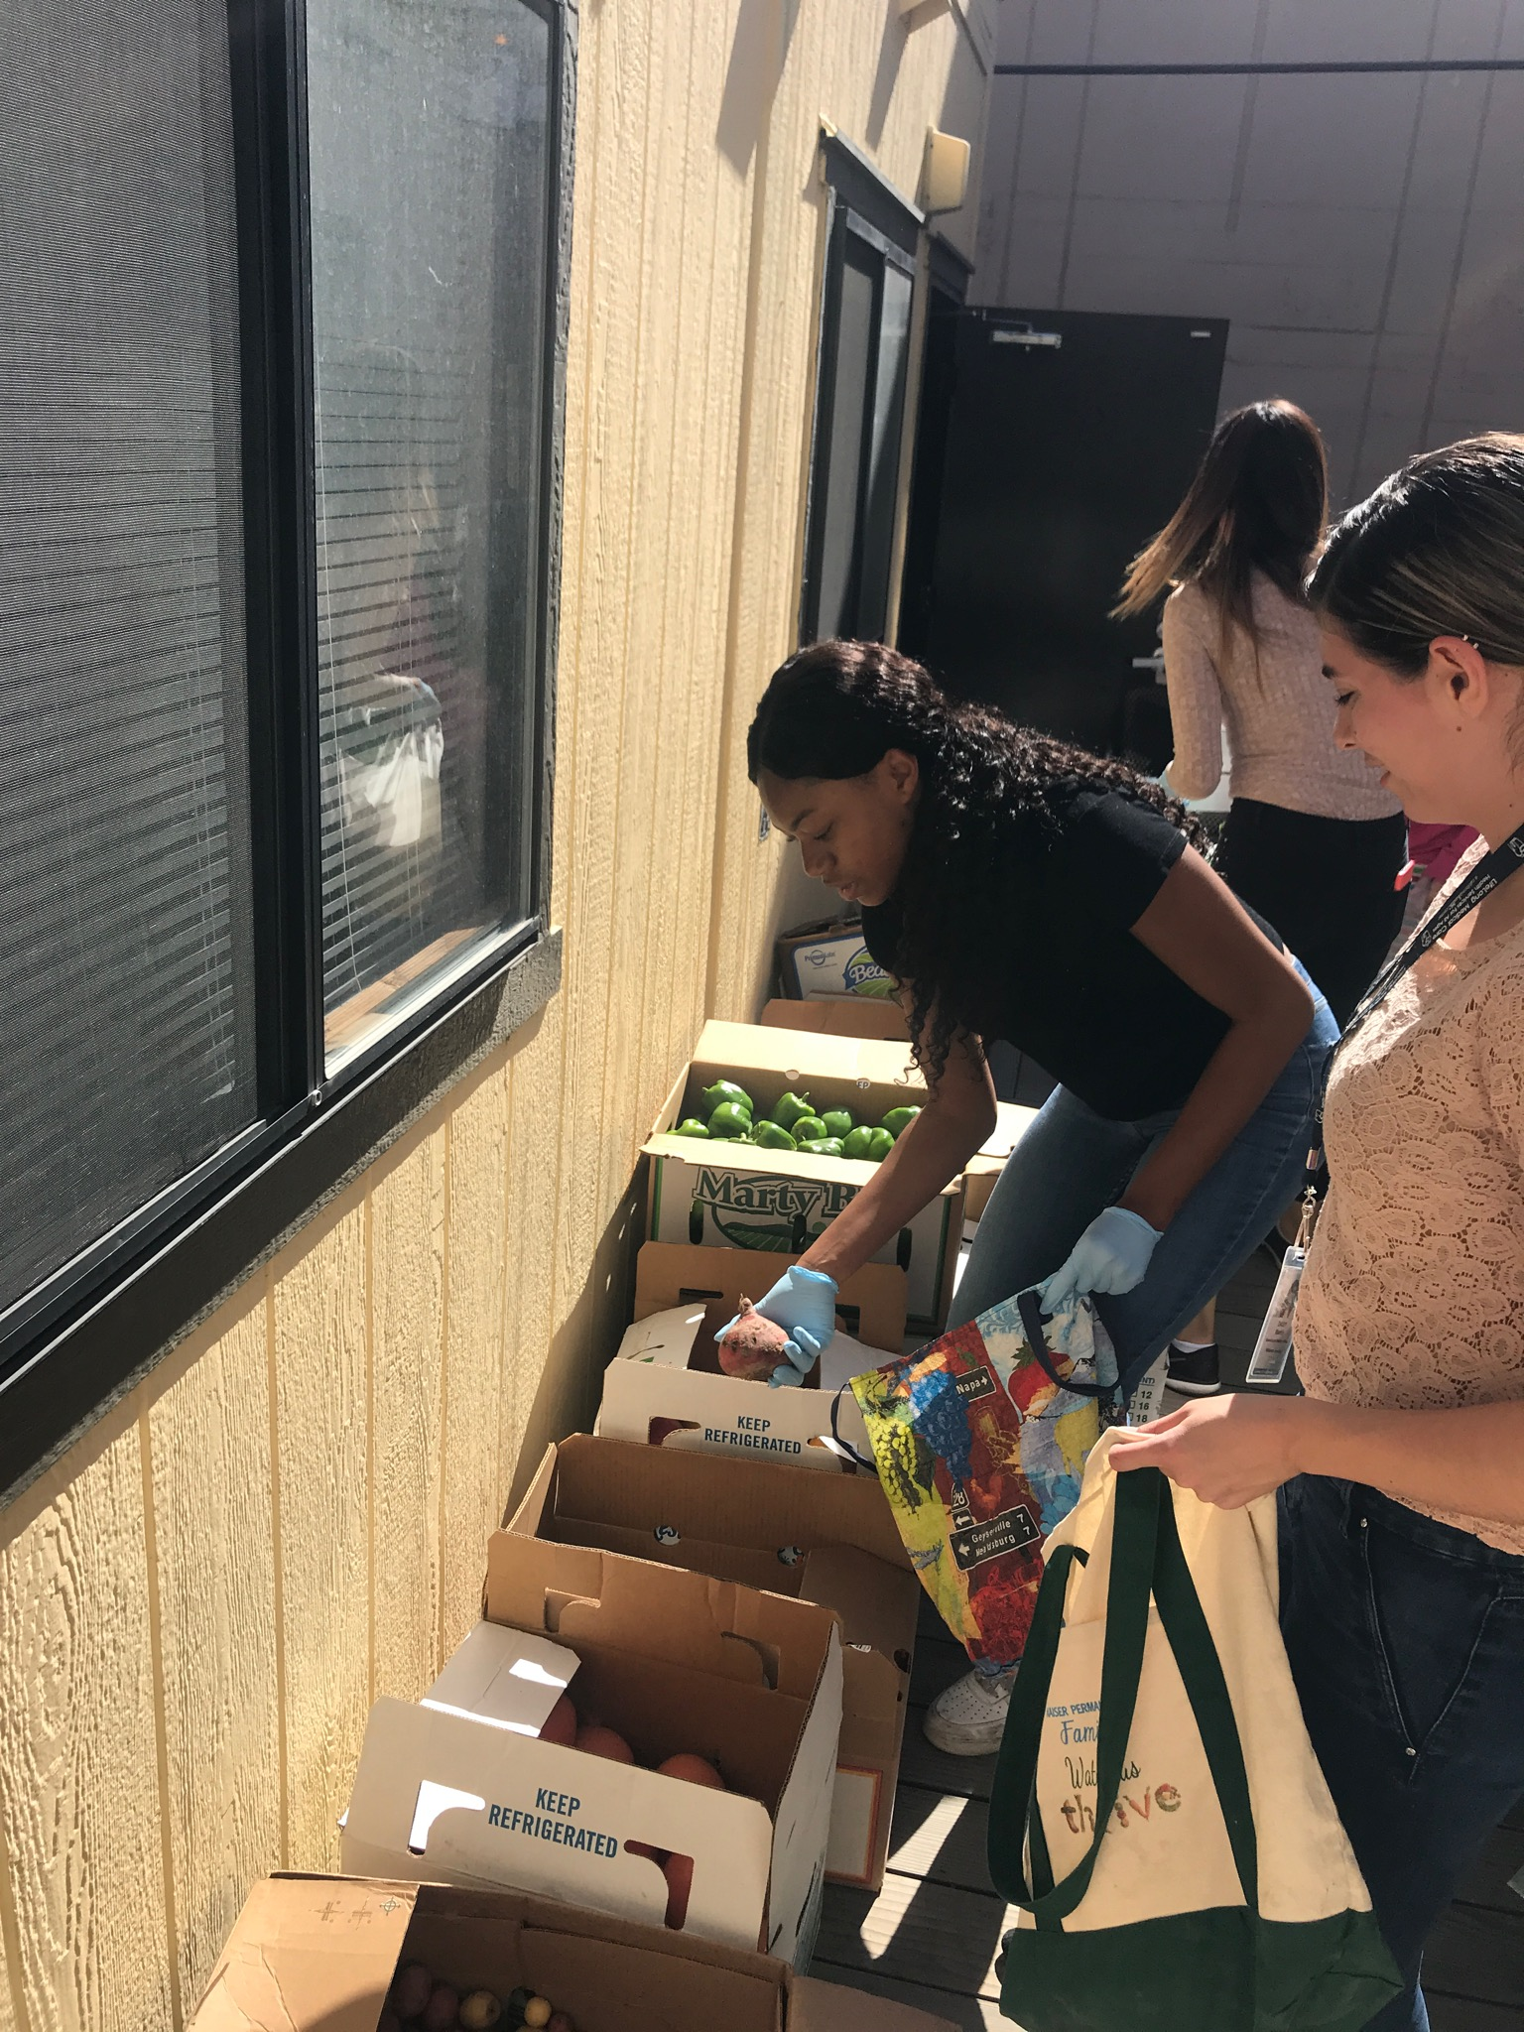
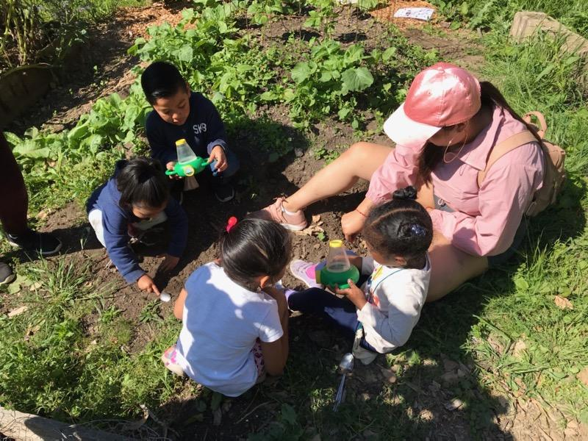
“There is no power for change greater than a community discovering what it cares about” - Margaret J. Wheatley

